Slide 1
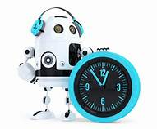
FOUNDATION PHASE TIME TABLE
GRADE 1,2 & 3

Slide 2
  Time allocation – Foundation Phase
Introducing changes to notional time in the Foundation Phase curriculum involves clear communication and strategic planning. Stakeholders, including teachers, school leaders, and parents, must understand the concept of notional time and its role in balancing core subjects with new additions like Coding and Robotics.

Slide 3
Notional Time
Grade 1 & 2
Without Coding and Robotics | With Coding Robotics
Home Languages – 7 Hours | Home Languages – 7 Hours
Mathematics – 7 Hours | Mathematics – 7 Hours
Life Skills – 6 Hours | Life Skills – 5 Hours
First Add. Languages – 3 Hours | First Languages – 3 Hours
 | Coding and Robotics – 1 Hour
23 hours | 23 hours

Slide 4
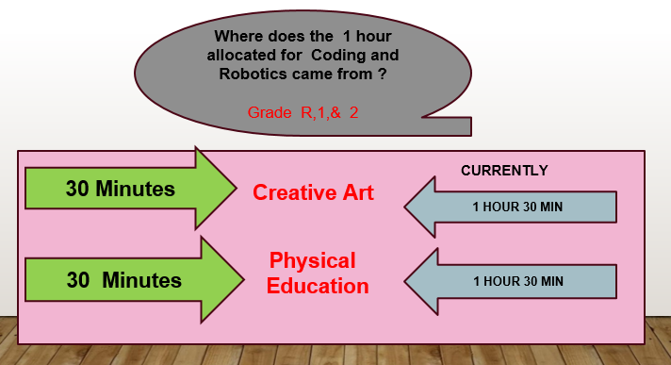

Slide 5
Notional Time
GRADE 3
Without Coding and Robotics | With Coding Robotics
Home Languages – 7 Hours | Home Languages – 7 Hours
Mathematics – 7 Hours | Mathematics – 7 Hours
Life Skills – 7Hours | Life Skills – 5 Hours
First Add. Languages – 4 Hours | First Languages – 4 Hours
 | Coding and Robotics – 2 Hour
25 hours | 25 hours

Slide 6
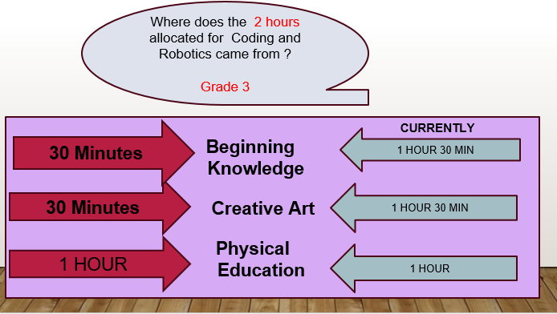

Slide 7
LIFE SKILLS
GRADE 1 &2 | GRADE 3
Beginning knowledge -1hour | Beginning knowledge – 2 hour
Personal and Social Wellbeing - 1hour | Personal and Social Wellbeing - 1hour
Creative art ( Performing Art and Visual Art )- 2 hours | Creative art ( Performing Art and Visual Art )- 2 hours
Physical Education – 2 hours | Physical Education – 2 hours
6 hours | 7 hours

Slide 8
LIFE SKILLS
GRADE 1 &2 | GRADE 3
Beginning knowledge -1hour | Beginning knowledge - 1h30mins
Personal and Social Wellbeing - 1hour | Personal and Social Wellbeing - 1hour
Creative art ( Performing Art and Visual Art )- 1h30mins | Creative art ( Performing Art and Visual Art )- 1h30mins
Physical Education – 1h30mins | Physical Education – 1 hour
5 hours | 5 hours

Slide 9
weighting of the
4 strands
Pattern recognition 15%
Algorithms and coding 50%
Robotics 30%
Digital concept 5%

Slide 10
Grade 1 and 2
DAY | 08H00-08H30 | 08H30-09H00 | 09H00-09H30 | 09H30-10H00 | 10H00-10H30 | 10H30-11H00 | 11H00-11H30 | 11H30-12H00 | 12H00-12H30 | 12H30-13H00 | 13H00-13H30
MONDAY | MATHS | MATHS | MATHS | HL | B | HL | HL | L/S | FAL | L/S
TUESDAY | HL | HL | FAL | FAL | R | MATHS | MATHS | MATHS | L/S | HL | HL
WEDNESDAY | MATHS | MATHS | MATHS | HL | E | L/S | L/S | FAL | FAL | HL
THURSDAY | L/S | L/S | FAL | HL | A | MATHS | MATHS | MATHS | L/S | HL
FRIDAY | MATHS | MATHS | HL | HL | K | C & R (Algorithm and Coding) | C & R P/R/D | HL | L/S | L/S

Slide 11
Grade 3
DAY | 08H00-08H30 | 08H30-09H00 | 09H00-09H30 | 09H30-10H00 | 10H00-10H30 | 10H30-11H00 | 11H00-11H30 | 11H30-12H00 | 12H00-12H30 | 12H30-13H00 | 13H30-14H00
MONDAY | MATHS | MATHS | MATHS | HL | B | C & R (Algorithm and Coding) | HL | L/S | FAL | L/S | HL
TUESDAY | HL | HL | FAL | FAL | R | MATHS | MATHS | MATHS | L/S | HL | HL
WEDNESDAY | MATHS | MATHS | MATHS | HL | E | C & R (Algorithm and Coding) | L/S | FAL | FAL | HL | HL
THURSDAY | L/S | L/S | FAL | HL | A | C & R (Robotics) | MATHS | MATHS | MATHS | HL | L/S
FRIDAY | MATHS | MATHS | HL | HL | K | C & R (P/D) | L/S | L/S | FAL | FAL | L/S

Slide 12
Thank you

